Slide 1
INTERNSHIP PRESENTATION
NAME : Farees Ahmed shaikh
USN : 4MW18CS025
Role : Data visualization analyst

Slide 2
AGENDA
COMPANY PROFILE
CERTIFICATE
PROJECT OVERVIEW
TASKS PERFORMED
TECHNOLOGIES USED
FUTURE SCOPE

Slide 3

COMPANY PROFILE
Tequed Labs is a research and development center and educational institute based in Bangalore started by Mr Aditya S K and Mr Supreeth Y S. They are focused on providing quality education on latest technologies and develop products which are of great need to the society.
Description: The company provides IOT and application development services.
They are also involved in the distribution and sales of latest electronic innovation products developed all over the globe to their customers . They run a project consultancy where various projects from a wide range of companies are undertaken and assist them technically to build products and provide services.
and assist them technically to build products and provide services.
They are also continuously involved in research about futuristic technologies and finding ways to simplify them for students.
Products & Services: Android Applications Development, Website Development Service, IOT services
Category: Service Provider

Slide 4

CERTIFICATE

Slide 5
PROJECT OVERVIEW
Created a model for predicting the selling price for used bikes.
Used pandas python dataframe modules to clean and transform the data scikit-learn python machine-learning module to analyse and visualize the data.
This model predicts the price the price of the used bike based on brand, usage, area of selling.
Provides a base-line for buyers and sellers in the second hand vehicle market.

Slide 6
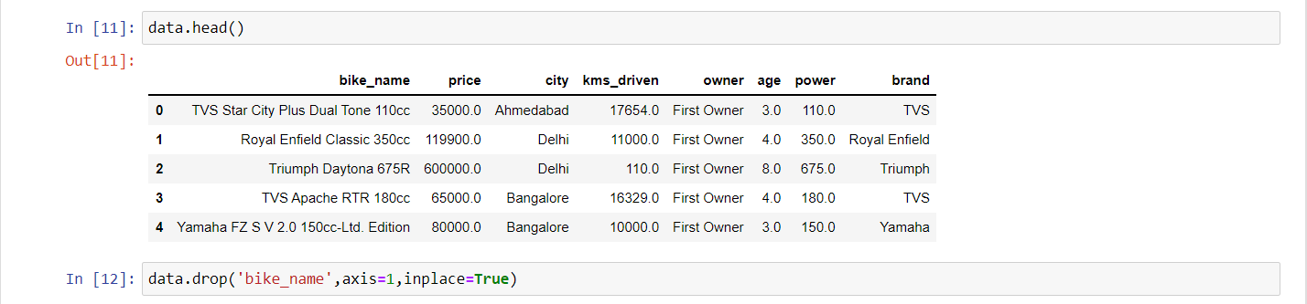
TASKS PERFORMED
Data Acquisition and Cleaning:
The Input Variables are:
Bike_name
Price
City
Kms_driven
Owner
Age
Power
Brand
The output will be the prices of the bikes within a range and the value will be plotted in the form of a scatter plot.

Slide 7
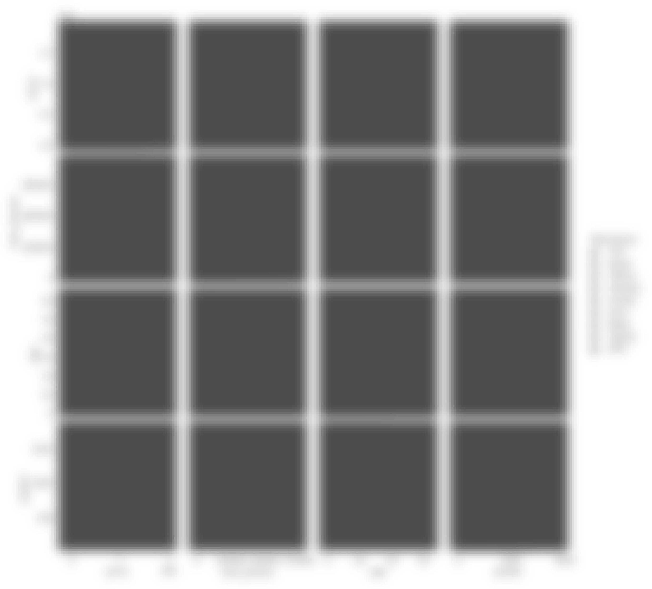
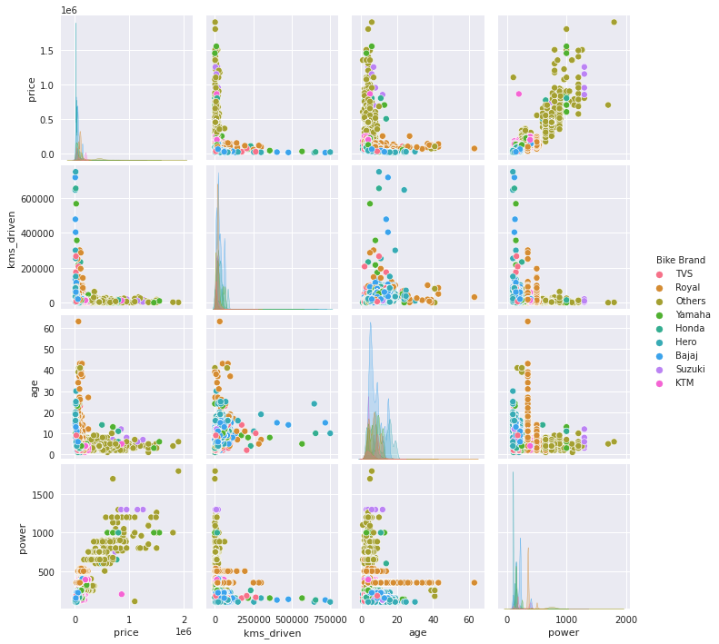
Data Visualization :
Here, we use various graphs to plot our data in an easily visualizable manner.
Histograms and bar graphs are one of the best ways to visualise data in a two dimensional format.
Pair Plots are a really simple way to visualize relationships between each variable. It produces a matrix of relationships between each variable in your data for an instant examination of our data. It can also be a great jumping off point for determining types of regression analysis to use:

Slide 8
Data Modeling:
First, we find out all the values of the cities we are training the model for and we eliminate the cities whose number of values is below a certain threshold.
Then we will count the values of the owners within the descending order, the owners from the second to the last will then be represented by the same Second and more owner and all the values will be summed for these values .
Then the columns will be encoded to the first ten samples with the first value drop to be true after which we will then find the sum of all the values which are not available. The price axis will be dropped and the x and y shape will be represented.
The Linear Regression value will be used and the model will be fitted x train and y train and then the value will then be tested with x test and y test value, x train and y train value.

Slide 9
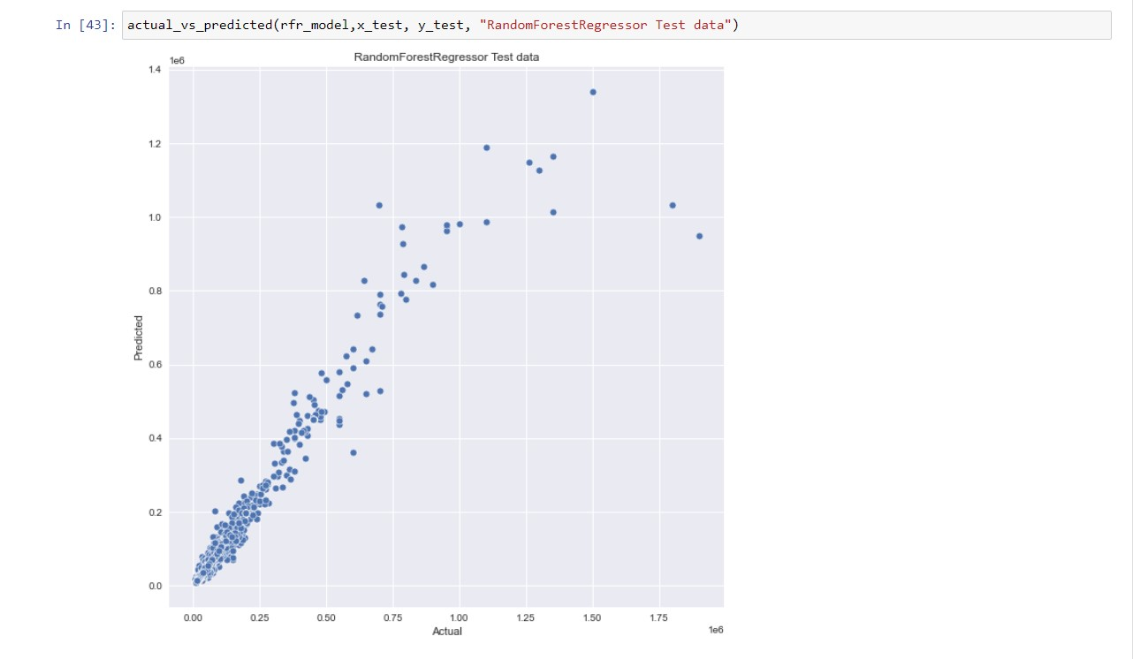
Comparison and Measurement :
After data acquisition, cleaning, visualization, modeling, testing we are the data comparison step. In this step, we will compare the predicted value of the model to the actual value of the outcome using Random Forest Regression.
Random Forest Regression is a supervised learning algorithm that uses the ensemble learning method for regression. A Random Forest Regression model is powerful and accurate. It usually performs great on many problems, including features with non-linear relationships.
The methods used are:
Step 1: Identify your dependent (y) and independent variables (x)
Step 2: Split the dataset into the Training set and Test set
Step 3: Training the Random Forest Regression model on the whole dataset
Step 4: Predicting the Test set results.

Slide 10
TECHNOLOGIES USED
scikit-learn
Machine Learning in Python
Simple and efficient tools for predictive data analysis
Accessible to everybody, and reusable in various contexts
Built on NumPy, SciPy, and matplotlib
Open source, commercially usable - BSD license

Slide 11
FUTURE SCOPE
Can be extended to include a wider variety of brands and vehicles.
Can be integrated into existing marketing platforms to improve user experience and set customer expectations.
Include an actual user interface for better experience.
Can be altered following further feedback.

Slide 12
THANK YOU

